Slide 1


Juan Pellejero Solans
23 / 09 / 2022

Slide 2

Outline
Executive Summary
Introduction
Methodology
Results
Conclusion
Appendix

Slide 3
Executive Summary
Summary of methodologies
Data was collected through API and Web scraping
Data was then pre-processed accordingly (Data Wrangling)
Exploratory data analysis was implemented through SQL and Visualization methods
A visual analysis was implemented using Folium
A final prediction was obtained used Machine Learning Prediction
Summary of all results
Results from Exploratory Data Analysis
Interactive graphic results
A result from the predictive analysis

Slide 4
Introduction
Project background and context
SpaceX is currently using Falcon 9 rocket launchers, advertised on its website at a cost of 62M$. (Being M$ million dollars). The sector competitor providers, use rocket launchers with cost upward of 165M$ each. The main reason of the savings are the reusability of the first stage that SpaceX offers. Being so, determining if the first stage returns safely is a main concern for expenses concerns. The goal of this project is determining whether a first stage lands safely for subsequent use.
Problems you want to find answers
¿What factors determine if the first stage lands safely?
¿How do these factors interact with each other to determine the success rate?
¿What other conditions must be met to guarantee a successful landing?

Slide 5

Section 1

Slide 6
Methodology
Executive Summary
Data collection methodology:
Data was collected using SpaceX API and web scrapping from Wikipedia tables using python.
Perform data wrangling
Additional columns were added, and categorical features were replaced with dummy variables using one-hot encoding
Perform exploratory data analysis (EDA) using visualization and SQL
Perform interactive visual analytics using Folium and Plotly Dash
Perform predictive analysis using classification models

Slide 7
Data Collection
Data was obtained using get request to the SpaceX API
Data was then “translated” from its home format to JSON using .json(), and then exported to a pandas dataframe with .json_normalize()
Data was pre-processed, eliminating NaN values and replacing missing values with mean values
Web scraping was performed to get Falcon 9 launch records out of Wikipedia record tables. This was done using BeautifulSoup
Every table obtained was then imported to its own pandas dataframe, for the purpose of ease of use.

Slide 8
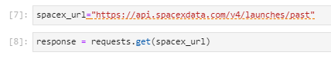
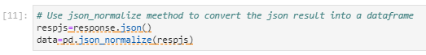
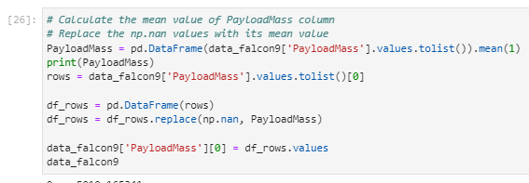
Data Collection – SpaceX API
Using the get request to the SpaceX API lets us collect data.
Link to the notebook (https://github.com/JPelleSol/-Data-Science-and-Machine-Learning-Capstone-Project-about-SpaceX-IBM-/blob/main/jupyter-labs-spacex-data-collection-api.ipynb)

Slide 9
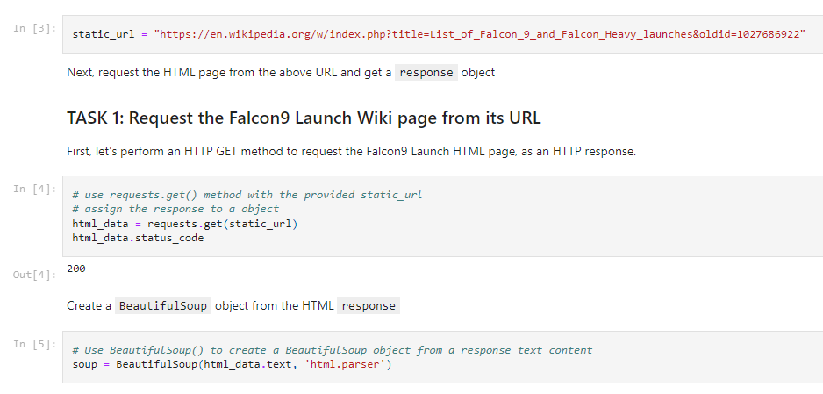
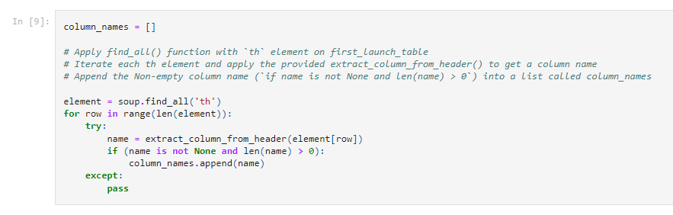
Data Collection - Scraping
BeautifulSoup was used to webscrap Falcon 9 launch data from Wikipedia
Data was then parsed and converted to pandas dataframe and csv
Link to the notebook (https://github.com/JPelleSol/-Data-Science-and-Machine-Learning-Capstone-Project-about-SpaceX-IBM-/blob/main/jupyter-labs-webscraping.ipynb)

Slide 10
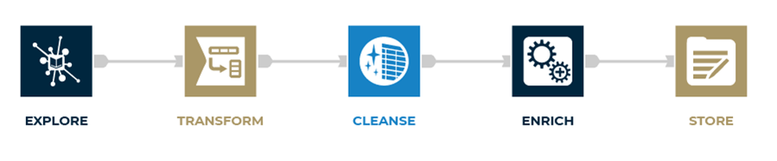
Data Wrangling
A landing outcome label was created out of the Outcome column into a similar dataframe, then it was exported to .csv
Link to the notebook (https://github.com/JPelleSol/-Data-Science-and-Machine-Learning-Capstone-Project-about-SpaceX-IBM-/blob/main/labs-jupyter-spacex-Data%20wrangling.ipynb)

Slide 11
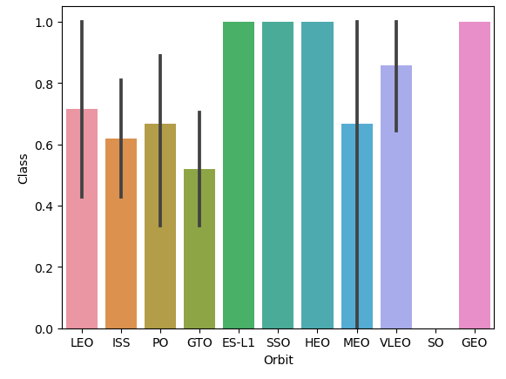
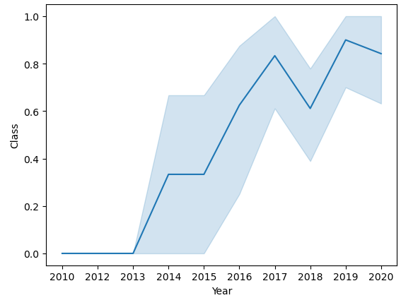
EDA with Data Visualization
An initial data analysis can be shown through visual relationships.
Two plots are presented stating a relationship between the success rate (Class) value and parameters such as orbit or year.
Link to the notebook (https://github.com/JPelleSol/-Data-Science-and-Machine-Learning-Capstone-Project-about-SpaceX-IBM-/blob/main/jupyter-labs-eda-dataviz%20(1).ipynb)

Slide 12
EDA with SQL
A SpaceX dataset named SPACEXTBL was imported into a SQL database. SQL lite was used in the Jupyter notebook for a EDA to get information from the data.
Queries done:
Unique launch sites
Total Payload Mass by NASA
Average Payload Mass
Successful vs Failure in recorded history
Table with failed drone landings, version and landing site.
Link to notebook (https://github.com/JPelleSol/-Data-Science-and-Machine-Learning-Capstone-Project-about-SpaceX-IBM-/blob/main/jupyter-labs-eda-sql-edx_sqllite.ipynb)

Slide 13
Interactive Map with Folium
An interactive map can be found in the notebook below. It has information of:
Failure/Success in each location (Color graded)
Distances to coastline and transit routes
Actual locations of landing sites and NASA headquarters.
Link to notebook (https://github.com/JPelleSol/-Data-Science-and-Machine-Learning-Capstone-Project-about-SpaceX-IBM-/blob/main/lab_jupyter_launch_site_location.ipynb)

Slide 14
Predictive Analysis (Classification)
Numpy and Pandas libraries were used to do a train-test split
Diverse machine learning models were implemented to obtain its hyperparameters using GridSearchCV
Acuraccy was the metric used for the model deployment. They were compared using confusion matrixes.
Link to the notebook (https://github.com/JPelleSol/-Data-Science-and-Machine-Learning-Capstone-Project-about-SpaceX-IBM-/blob/main/SpaceX_Machine%20Learning%20Prediction_Part_5.ipynb)

Slide 15

Section 2

Slide 16
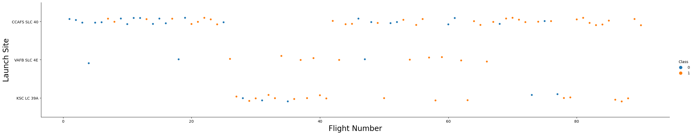
Flight Number vs. Launch Site
A relation between number of flights per launching site and success rate can be noted.

Slide 17
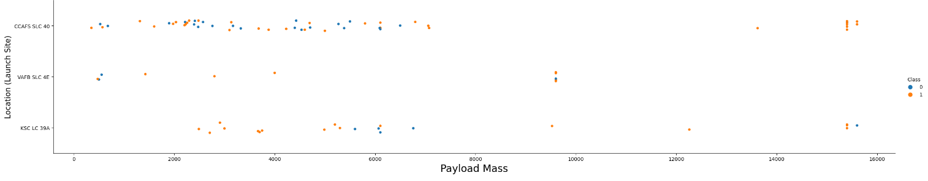
Payload vs. Launch Site
A relation between payload in each launching site and success rate can be noted

Slide 18
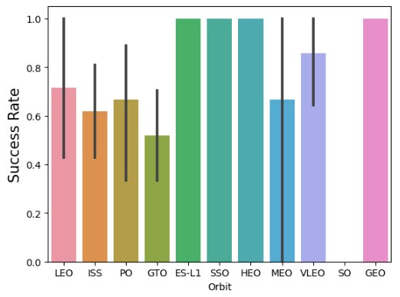
Success Rate vs. Orbit Type
It is observed that ES-L1, HEO, SSO, VLEO and GEO had a higher success rate. One possible cause is the longevity of the test used for the others (such as GTO). This is best seen in the next slide.

Slide 19
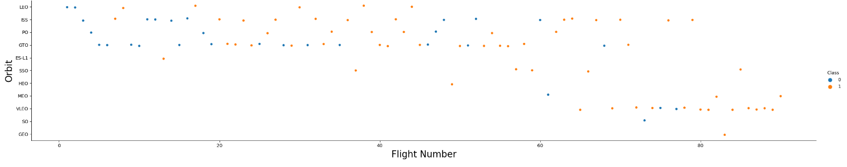
Flight Number vs. Orbit Type

Slide 20
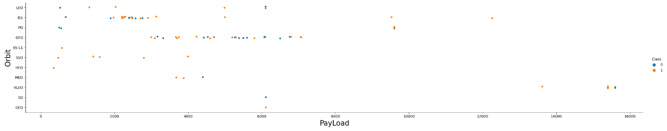
Payload vs. Orbit Type
Most heavy payloads are for PO, VLEO and ISS orbits. Matching with better success rate for such orbits.

Slide 21

Launch Success Yearly Trend
A consistent growth in success rate through the years can be stated through the plot

Slide 22
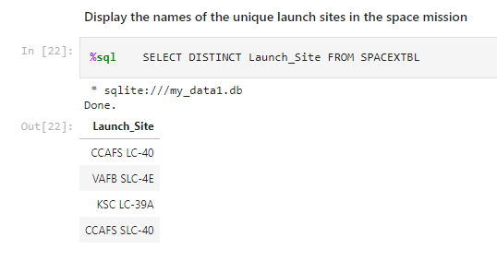
All Launch Site Names
A simple SQL input is enough to get all of SpaceX unique launch sites. In this case, we use DISTINCT

Slide 23
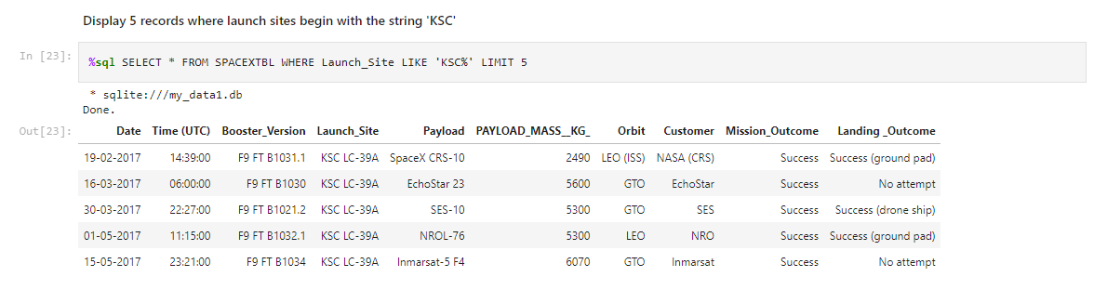
Launch Site Names Begin with 'KSC'
WHERE, a command from SQL allows for searches like this one

Slide 24
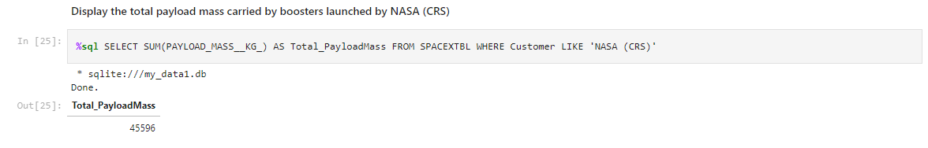
Total Payload Mass
In this case, a SQL query is used to get the total payload mass in Kg.

Slide 25
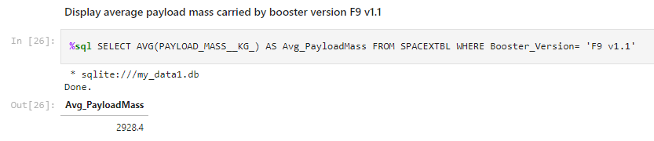
Average Payload Mass by F9 v1.1
Another query is used to get the average F9v1.1 payload mass in Kg.

Slide 26
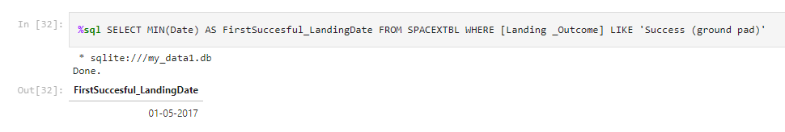
First Successful Ground Landing Date
We can find historical data, such as the first successful landing date, using SQL

Slide 27
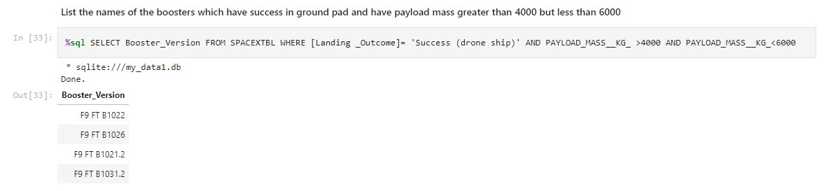
Successful Drone Ship Landing with Payload between 4000 and 6000
Complex requests as this one are most simple using SQL. Another query is used for this.

Slide 28
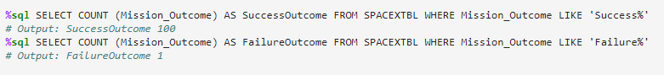
Total Number of Successful and Failure Mission Outcomes
Two separate queries were run for this question. The results are shown correspondingly in comment form below each one.

Slide 29
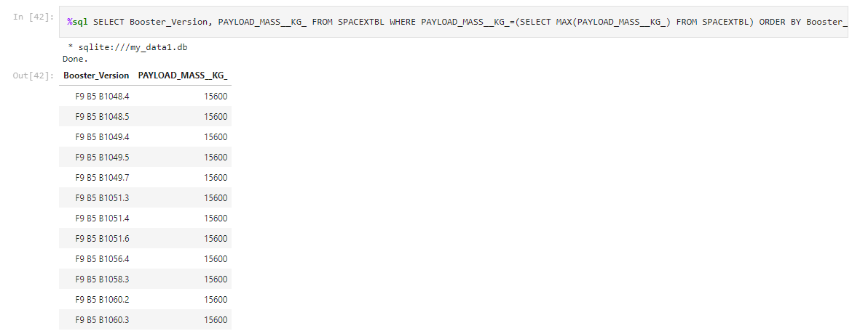
Boosters Carried Maximum Payload
We can make tables with SQL. In this case, a top payload mass table is done using SELECT.

Slide 30
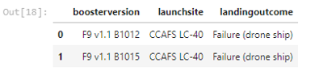
2017 Launch Records
A SQL table can be as concrete as desired

Slide 31
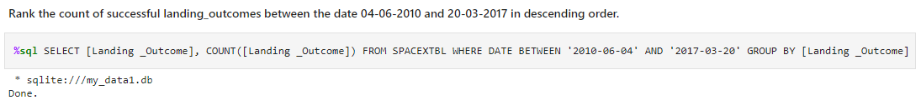
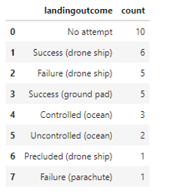
Rank Landing Outcomes Between 2010-06-04 and 2017-03-20
A COUNT can be used like this. Both landing outcome and count are selected with SELECT, specifying LandingOutcome for COUNT. Order by is then used for cleanness.

Slide 32

Section 3

Slide 33
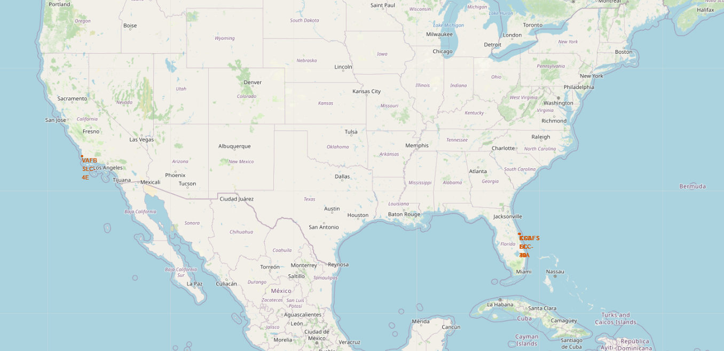
Launch sites: Map markers.
Launch locations are shown in the map

Slide 34
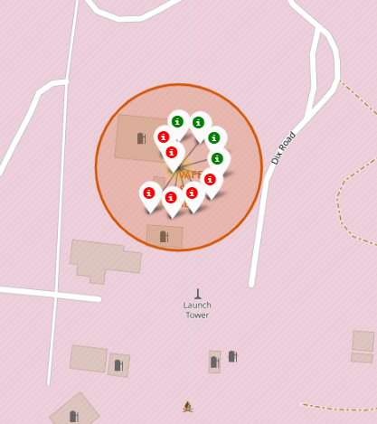
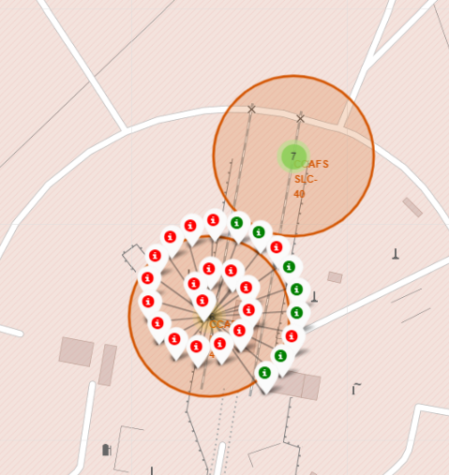
Color graded labels for markers
California on the left
Florida on the right

Slide 35
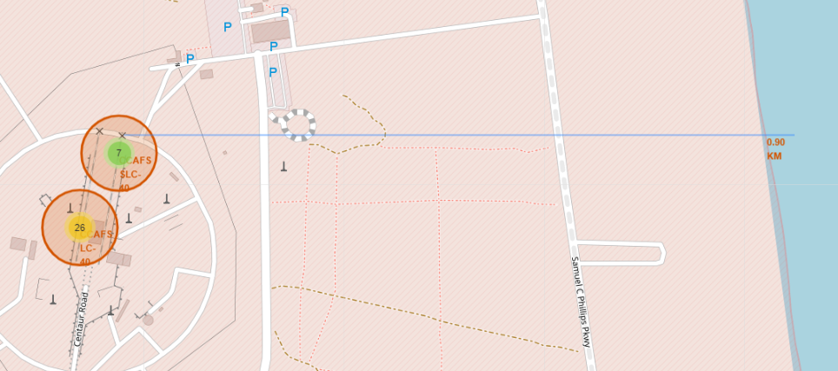
Distances to coastline, highways..
We are able to get distances from the launching site to key locations with folium. This is important for noise and
shockwave concerns. We can check that each location is safe for the oceans, transit ways and cities nearby.

Slide 36

Section 4

Slide 37
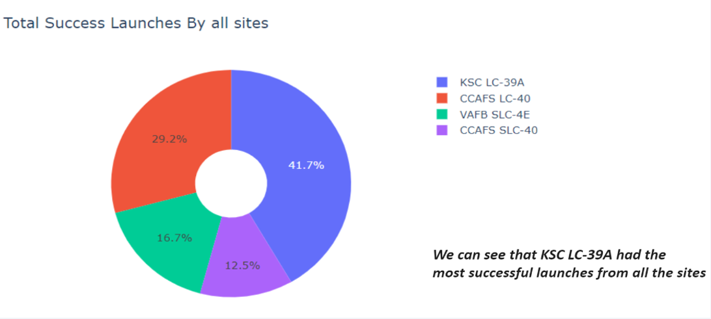
Pie chart: Success percentage by launch site

Slide 38
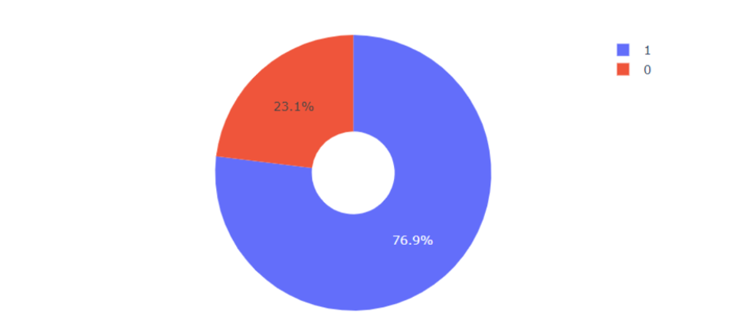
Pie Chart: Launching site with the most success ratio
Site KSC LC-39A has 76.9% success ratio. In the graph. Result 1 (blue) shows a success (Class = 1)

Slide 39
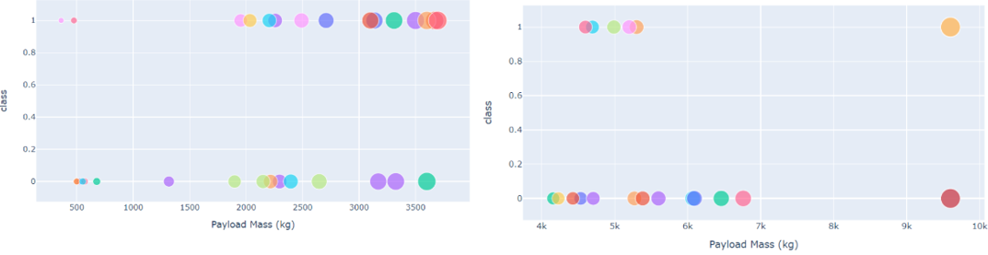
Scatter Plot: Payload and Launch Outcome for all sites (Interactive Graph)
Two graphs are presented, the first, with the slider set to 0-4000 Kg. The second, with the slider set to 4000-10000 Kg.
We find success rate (Class, on the graph) is higher for low payloads.

Slide 40

Section 5

Slide 41
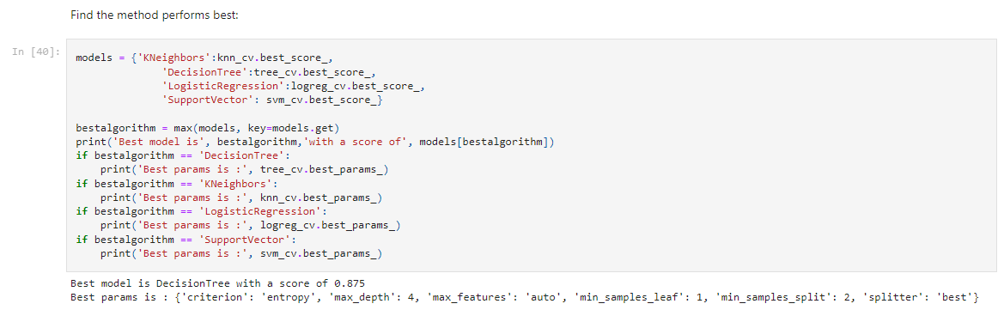
Classification Accuracy
We find Decission Tree to be the best classification algorithm. However, any of those has similar accuracy.

Slide 42
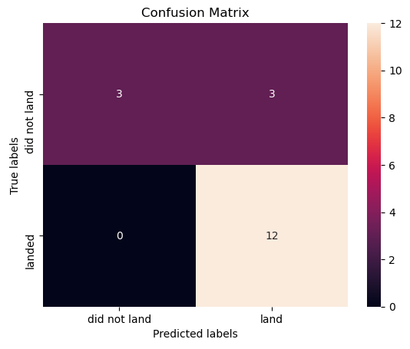
Confusion Matrix
The confusion matrix shows that the classifier throws a high number of false-positives. This is, unsuccessful landings noted as successful by the Decision Tree Classifier.

Slide 43
Conclusions
It can be concluded that:
Success Rate can be related to payload mass and flight amount at a launch site. The greater the flight amount, the greater the success, and the lesser the payload mass, the greater the success.
Orbits ES-L1, HEO, SSO and VLEO showed the most success rate. GEO can be noted, but with only 1 launch successful out of 1 total, it’s not conclusive enough.
Success rates have been improving through the years
KSC LC-39A is the best location to launch according to success rate.
From the models tested, the model that best predicts the outcomes of the launches, is a decision tree classifier. Even so, we would have to be weary with false positives from this classifier.

Slide 44


